Slide 1
MYSQL RDBMS DATA ANALYTICS
Food Waste Redistribution Analytics
Analysis of donors, food stock, collection centers, volunteers, recipients and distribution, with ER design and SQL methodology
DOMAIN
DATABASE
TOTAL VOLUME ANALYZED
Data Analytics & SQL
MySQL (8 Relational Tables)
1,250 Units Donated | 360 Distributed

Slide 2




WHY THIS PROJECT MATTERS
Surplus food is wasted while people go hungry
≈ 1/3
Social impact
Environmental impact
Feeds orphanages, old age homes, shelters and poor families with safe surplus food.
Keeps edible food out of landfills, cutting waste and the emissions it causes.
of all food produced for people is lost or wasted worldwide (FAO estimate)
Restaurants, hotels, caterers and supermarkets often have edible surplus, but no organised way to route it before it expires.
Economic value
Accountability
Donors reduce disposal cost; charities reduce what they must buy.
Every donation and distribution is recorded, so food can be traced end to end.
Food Waste Redistribution System
2
Notes:
The FAO figure is a widely cited global estimate. The project is a small-scale database answer to a real logistics problem.

Slide 3




PROJECT OVERVIEW
How food moves through the system
Donors donate
Centers store
Distribution
Recipients receive
DONORS, DONATIONS
COLLECTION_CENTERS, FOOD_ITEMS
DISTRIBUTIONS, DISTRIBUTION_DETAILS
RECIPIENTS
PROJECT OBJECTIVES
Store donors, food items, centers, volunteers and recipients in a normalised relational schema.
Record every donation and every distribution with quantities and dates.
Answer operational questions with SQL: totals, rankings, unmatched stock, per-center staffing.
Reuse logic through a view and stored procedures.
Food Waste Redistribution System
3

Slide 4
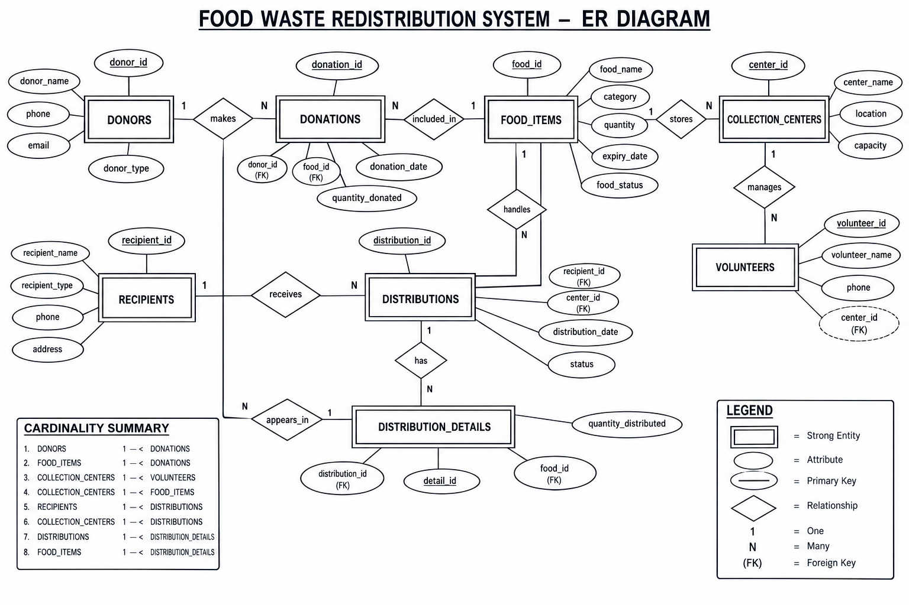
DATABASE ARCHITECTURE
Relational schema and ER model
Table groups
Donors & Donations
Who gives food, and how much each donor gives.
Food Items & Centers
Stock, expiry dates and where food is stored.
Volunteers
Staff assigned to each collection center.
Recipients & Distributions
Who receives food, and what is delivered.
Food Waste Redistribution System
4
Notes:
Chen-style ER diagram of the implemented database. The cardinality summary in the corner lists all 8 relationships.

Slide 5






TECHNOLOGY STACK
Tools and SQL concepts used
MySQL
MySQL command-line client
SQL: DDL, DML, DQL
Relational database engine. Database food_waste_redistribution with 8 tables.
Used to run every script and query, as shown in the mysql> session output.
CREATE / DROP for structure, INSERT for data, SELECT for analysis.
Constraints
ER modelling
Advanced objects
PRIMARY KEY, FOREIGN KEY, NOT NULL and AUTO_INCREMENT keep data consistent.
Entity-relationship diagram in crow's foot notation guides the schema.
A VIEW for reporting and stored PROCEDURES with an input parameter.
Query techniques covered: SELECT, WHERE, aggregate functions, INNER and LEFT JOIN, GROUP BY, HAVING, ORDER BY / LIMIT, subqueries, NOT IN.
Food Waste Redistribution System
5

Slide 6
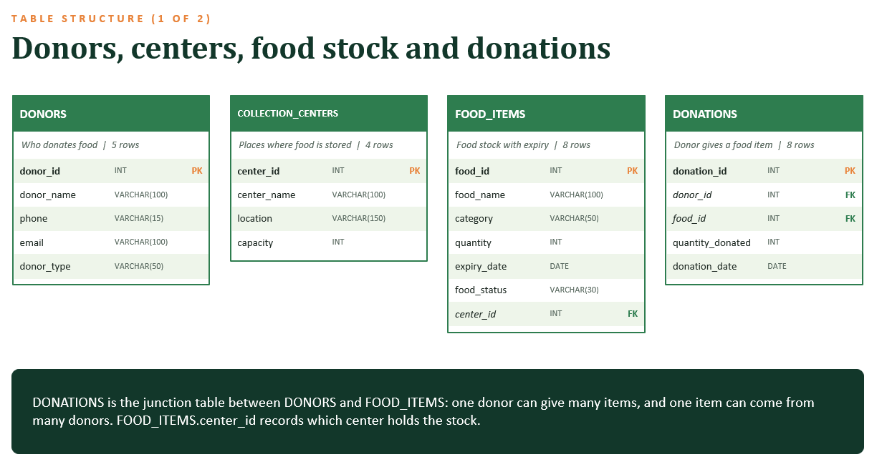
Food Waste Redistribution System
6

Slide 7
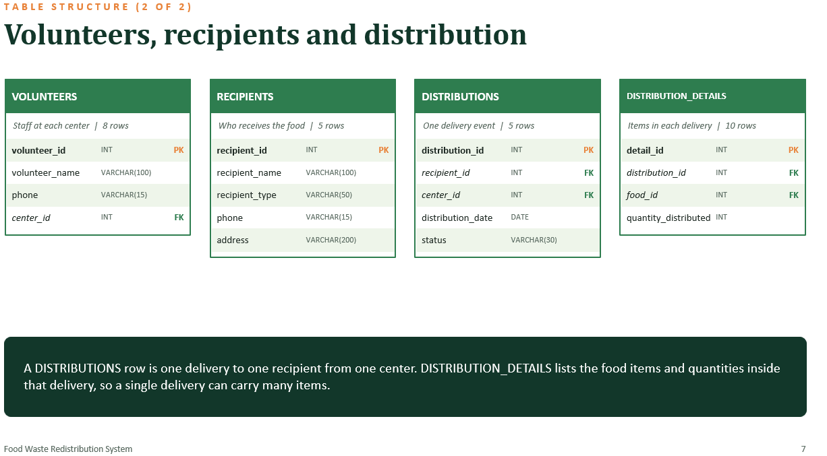

Slide 8
DONOR PERFORMANCE
Two donors supply almost half of all food
Fresh Bites Restaurant
300 Units
Restaurant
24.0% share
48%
Annapurna Catering
300 Units
Catering
24.0% share
Top 2 donors
Green Leaf Hotel
250 Units
Fresh Bites Restaurant and Annapurna Catering together gave 600 of 1,250 units. The average donation is 156.25 units across 8 donations.
Hotel
20.0% share
City Supermarket
200 Units
Supermarket
16.0% share
Food Care NGO
200 Units
NGO
16.0% share
Food Waste Redistribution System
8

Slide 9
FOOD ITEM PERFORMANCE
Rice is the most donated item
1
2
3
4
5
Rice
Dal
Wheat
Biscuits
Fruits
Grains
Pulses
Grains
Packaged Food
Fresh Food
500
200
150
120
100
units donated
units donated
units donated
units donated
units donated
Rice alone is 40% of all donations (500 of 1,250 units), received from two donors. Vegetable Curry also had 100 units, tied with Fruits. Bread (80 units) was the least donated item.
Food Waste Redistribution System
9

Slide 10
CATEGORY ANALYSIS
Grains make up almost half of the stock
Pulses
250 units
DOMINANT CATEGORY
Dal
13.9% share
Grains
Fresh Food
200 units
Fruits
11.1% share
800
Packaged Food
180 units
Biscuits
10.0% share
units in stock, 44.4% of 1,800 total
Cooked Food
150 units
Vegetable Curry
8.3% share
Rice (500) and Wheat (300) are both stored at the Central Food Center.
Dairy
120 units
Milk
6.7% share
Bakery
100 units
Bread
5.6% share
Food Waste Redistribution System
10
Notes:
Stock quantities come from the FOOD_ITEMS table, grouped by category. Total stock is 1,800 units.

Slide 11
COLLECTION CENTER ANALYSIS
Central Food Center is 80% full while others have room
Central Food Center
80.0% used
3 volunteers
South Food Center
61.4% used
2 volunteers
North Distribution Center
43.8% used
2 volunteers
Community Food Hub
36.7% used
1 volunteer
Community Food Hub has the lowest staffing and the lowest use of its capacity.
Food Waste Redistribution System
11

Slide 12
RECIPIENT ANALYSIS
Children's homes received the most food
Care Children Center
90 Units
Children Home, Anakapalle
25.0% share
44.4%
Poor Families Association
85 Units
Community, Visakhapatnam
23.6% share
Went to children
Helping Hands Orphanage
70 Units
Care Children Center and Helping Hands Orphanage received 160 of the 360 units distributed. All 5 distributions are marked Completed.
Orphanage, Visakhapatnam
19.4% share
Hope Old Age Home
70 Units
Old Age Home, Vizianagaram
19.4% share
Community Shelter
45 Units
Shelter, Gajuwaka
12.5% share
Food Waste Redistribution System
12

Slide 13
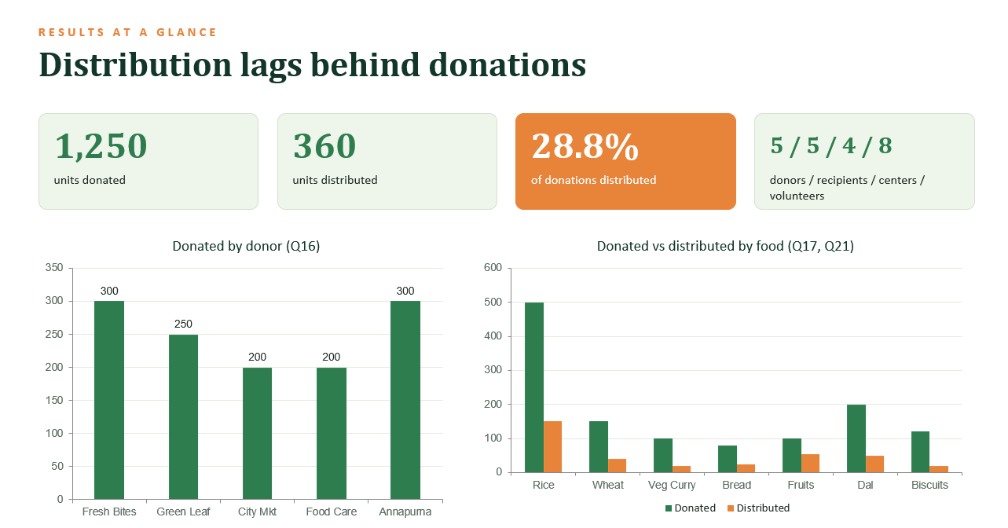
Food Waste Redistribution System
13
Notes:
28.8% = 360 distributed / 1,250 donated. Based on the sample data in the SQL file.

Slide 14
EXPIRY RISK
Four items expire within five days
2026-10-01
2026-10-02
2026-10-03
2026-10-05
Milk
Vegetable Curry
Bread
Fruits
Dairy
Cooked Food
Bakery
Fresh Food
120
0
150
20
100
25
200
55
units in stock
units distributed
units in stock
units distributed
units in stock
units distributed
units in stock
units distributed
Half of the 8 food items expire between 1 and 5 October 2026 (counted from 2026-10-01). The other four (Rice, Wheat, Dal, Biscuits) last until 15 Oct 2026 or later. Expiry-first distribution is the clearest improvement.
Food Waste Redistribution System
14

Slide 15



TECHNICAL EXECUTION
SQL analytical methodology
BASIC LEVEL
INTERMEDIATE LEVEL
ADVANCED LEVEL
Retrieval and aggregates
Joins and grouping
Subqueries and views
SELECT with WHERE filters, and SUM, AVG, COUNT, MAX and MIN for totals, averages and extremes.
INNER and LEFT JOIN across 2 to 5 tables, with GROUP BY, HAVING, ORDER BY and LIMIT for rankings.
Nested subqueries, NOT IN checks, a reporting VIEW and stored procedures with parameters.
32 statements in total: 30 queries (including 1 view) and 2 stored procedures.
Food Waste Redistribution System
15

Slide 16






WHAT THE PROJECT STILL NEEDS
Gaps found in the current version
Automatic stock updates
Expiry alerts
Requests and matching
FOOD_ITEMS.quantity is not reduced when food is distributed. Triggers or transactions should keep stock in sync.
No query or scheduled event flags items close to expiry, such as Milk expiring 2026-10-01.
Recipients cannot raise requests, and nothing matches surplus to need or priority.
Pickup and quality checks
Data integrity
Security and audit
No records of who collected food or whether it passed a safety check.
Add CHECK constraints, lookup tables for status and category, units of measure, NOT NULL rules and indexes.
Add user roles with GRANT permissions and an audit log of changes.
Food Waste Redistribution System
16

Slide 17
FUTURE IMPROVEMENTS
A three-phase roadmap
1
Harden the database
2
Build the application
3
Add intelligence and scale
Triggers to update stock
Indexes and CHECK constraints
Scheduled expiry-alert event
Add REQUESTS, PICKUP, VERIFICATION and EXPIRY tables
Web and mobile app with a REST API
SMS or WhatsApp notifications
Dashboards in Power BI or Tableau
Role-based login for donors, NGOs, volunteers
GPS routing for pickups (LOCATIONS lat/long)
Demand forecasting with machine learning
IoT cold-chain temperature tracking
QR-code verification; multi-city cloud deployment
Food Waste Redistribution System
17

Slide 18

STRATEGIC OUTLOOK
Key recommendations
Expiry-first distribution
Balance the centers
Raise the distribution rate
Send Milk, Vegetable Curry, Bread and Fruits out first, and add an automatic alert for items close to expiry.
Move stock from the Central Food Center (80% full) towards North and Community Food Hub, and add volunteers at the Hub.
Only 28.8% of donations reach recipients. Add more recipients and regular delivery schedules to close the 890-unit gap.
Food Waste Redistribution System
18

Slide 19
Conclusion
1
8-table MySQL database
Donors to recipients, fully linked with primary and foreign keys.
2
Data-driven insights
Donor, food, center and recipient analysis shows where food is donated, stored, delivered and at risk of expiring.
3
Clear path forward
Stock triggers, expiry alerts, requests, pickup and verification would make it a production-ready network.
Thank you. Questions?

